Slide 1
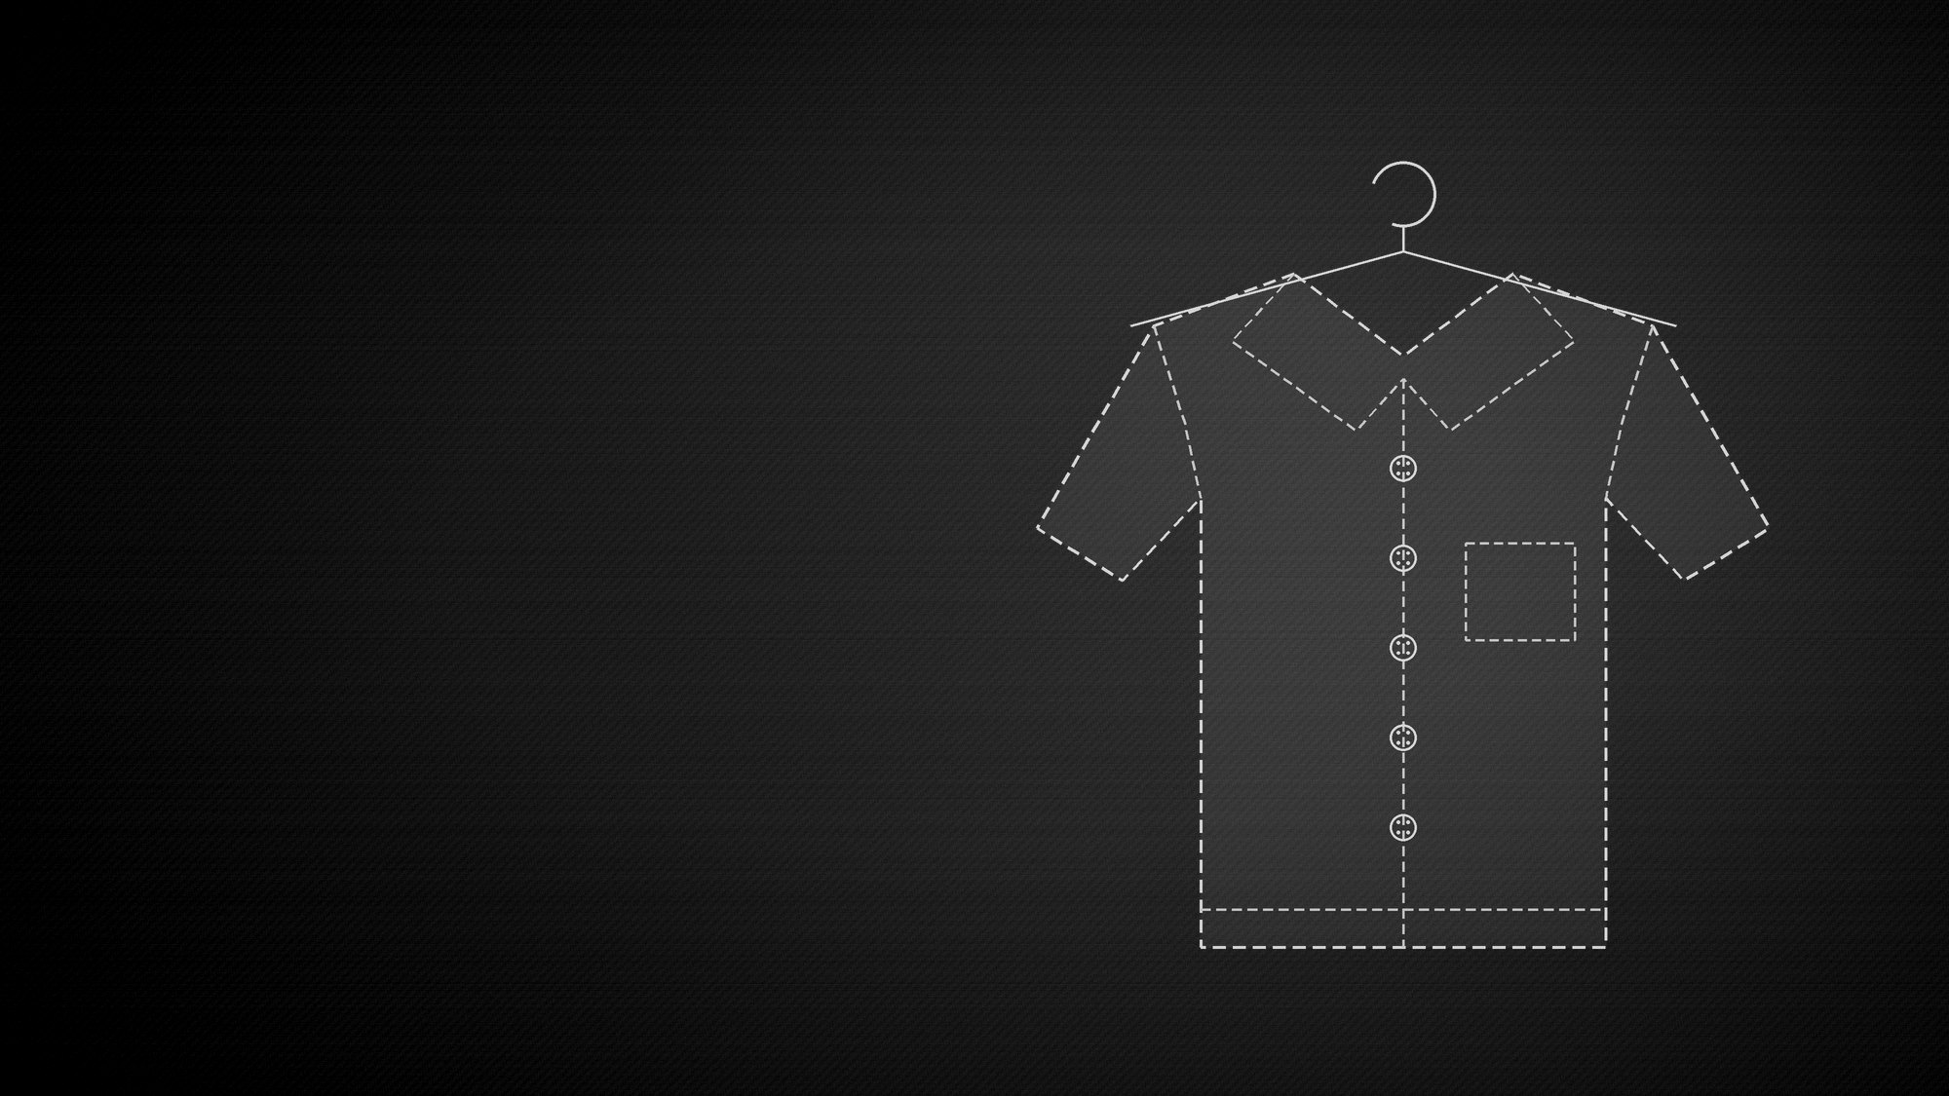

DIGITAL MARKETING
CASE STUDY
From digital-first menswear to omnichannel fashion growth.
TEAM MEMBERS
DATE
Siddharthsinh Parmar
September 2026
Portfolio case study • Public information + proposed strategy
01

Slide 2
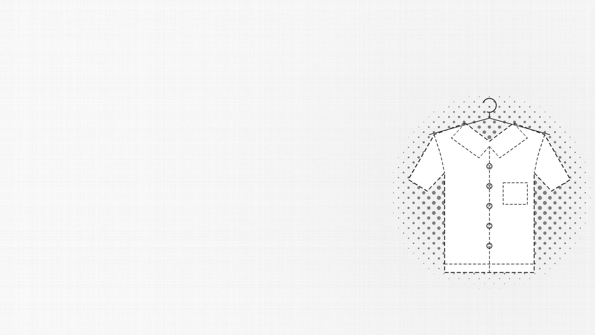
02 / SNITCH CASE STUDY
SNITCH
Brand Introduction
What is SNITCH, when did it start, and what makes the model distinctive?
Indian men's fashion brand focused on contemporary, trend-led apparel and a digitally driven shopping experience.
WHAT IS SNITCH?
Founded by Siddharth Dungarwal. The business evolved from apparel/retail roots into D2C and then omnichannel retail.
ORIGIN + FOUNDER
Trend responsiveness + broad assortment + accessible positioning + online convenience + growing physical retail.
USP
Business model: D2C + Omnichannel
Sources: SNITCH official website; Inc42 public reporting.
02

Slide 3

03 / SNITCH CASE STUDY
SNITCH
Problem Statement
The challenge is not only selling clothes — it is winning attention and retaining customers.
01 • COMPETITION
02 • CAC
03 • RETENTION
04 • SCALE
Zudio, H&M, Zara, Uniqlo, Myntra/AJIO and many D2C brands compete for the same attention.
Fashion advertising can become expensive when brands depend heavily on paid acquisition.
The brand needs repeat purchases, cross-sell and stronger customer lifetime value.
As offline stores grow, the challenge becomes integrating online, offline, CRM and data.
Core marketing question: How can SNITCH turn content-driven attention into profitable, repeatable customer growth?
Portfolio case study • Public information + proposed strategy
03

Slide 4

04 / SNITCH CASE STUDY
SNITCH
Target Audience + Buyer Persona
Portfolio-defined audience based on product and digital positioning.
DEMOGRAPHICS
BEHAVIOUR
PAIN POINTS
Age: 18–30
Location: Metro + Tier-1/Tier-2 India
Income: Student / early-career / middle-income
Device: Mobile-first
Discovers fashion through Instagram/Reels
Follows creators
Compares products online
Wants frequent newness
Responds to visual content
Price vs style trade-off
Fit uncertainty
Too many options
Needs outfit inspiration
Wants trend-led looks without premium pricing
Buyer Persona: “The Trend-Seeking Young Indian”
Audience/ persona are strategic assumptions for the portfolio, not disclosed SNITCH customer data.
04

Slide 5

05 / SNITCH CASE STUDY
SNITCH
Competitor Analysis
Three relevant reference points across price, trend and scale.
BRAND | POSITIONING | STRENGTH | SNITCH OPPORTUNITY
Zudio | Affordable fashion | Pricing + retail scale | Own trend-led men’s niche + digital community
H&M | Global fast fashion | Brand + assortment | More localized content + creator-led discovery
Zara | Premium fast fashion | Trend authority | Accessible price positioning + digital-first engagement
Note: This is a positioning comparison, not a market-share ranking.
Portfolio case study • Public information + proposed strategy
05

Slide 6
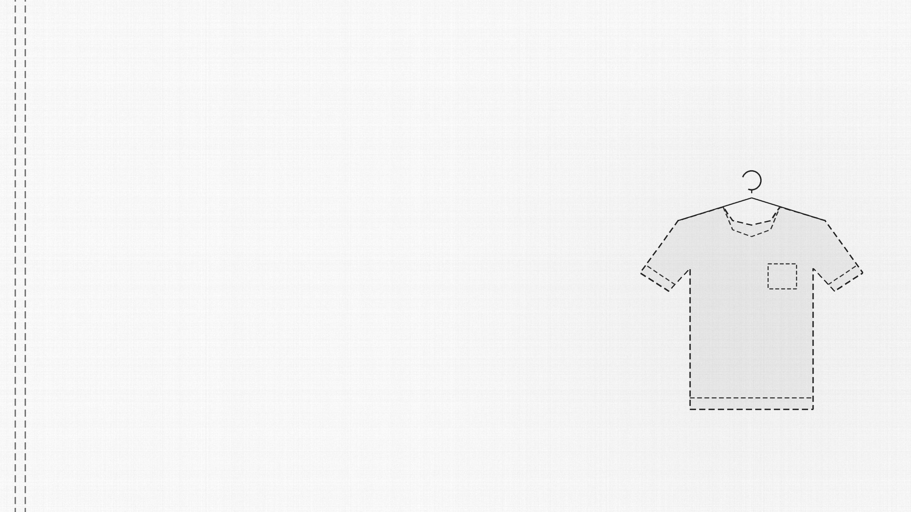
06 / SNITCH CASE STUDY
SNITCH
Current Digital Presence Audit
Use these as an audit framework; update live social counts on the day you submit the deck.
WEBSITE / APP
INSTAGRAM
D2C storefront • product catalogue • mobile-first conversion • owned customer data
Primary visual discovery channel • Reels • creators • product/styling content
YOUTUBE
FACEBOOK
Longer-form brand/creator potential • product stories • styling/video assets
Additional reach + retargeting ecosystem; useful for mature audience segments
Audit metrics to capture live: Followers • posting frequency • avg views • engagement • top content • website traffic • conversion signals.
Audit is qualitative here; social follower counts are intentionally left for live verification rather than fabricated.
06

Slide 7

07 / SNITCH CASE STUDY
SNITCH
Content Strategy / Campaign Idea
#SNITCHYourStyle — make customers part of the creative engine.
“Don’t copy the fit. Make it yours.”
HOOK
PRODUCT
STYLING
TREND
New drops • fit • fabric • details
3 ways to style • outfit formulas
Trend alerts • timely formats
LIFESTYLE
UGC
CREATORS
College • dates • travel • nightlife
Fit checks • reviews • customer looks
Micro creators • fashion creators
Platforms: Instagram → primary | YouTube → depth | Facebook → retargeting/reach | Website/App → conversion | CRM → retention
Portfolio case study • Public information + proposed strategy
07

Slide 8
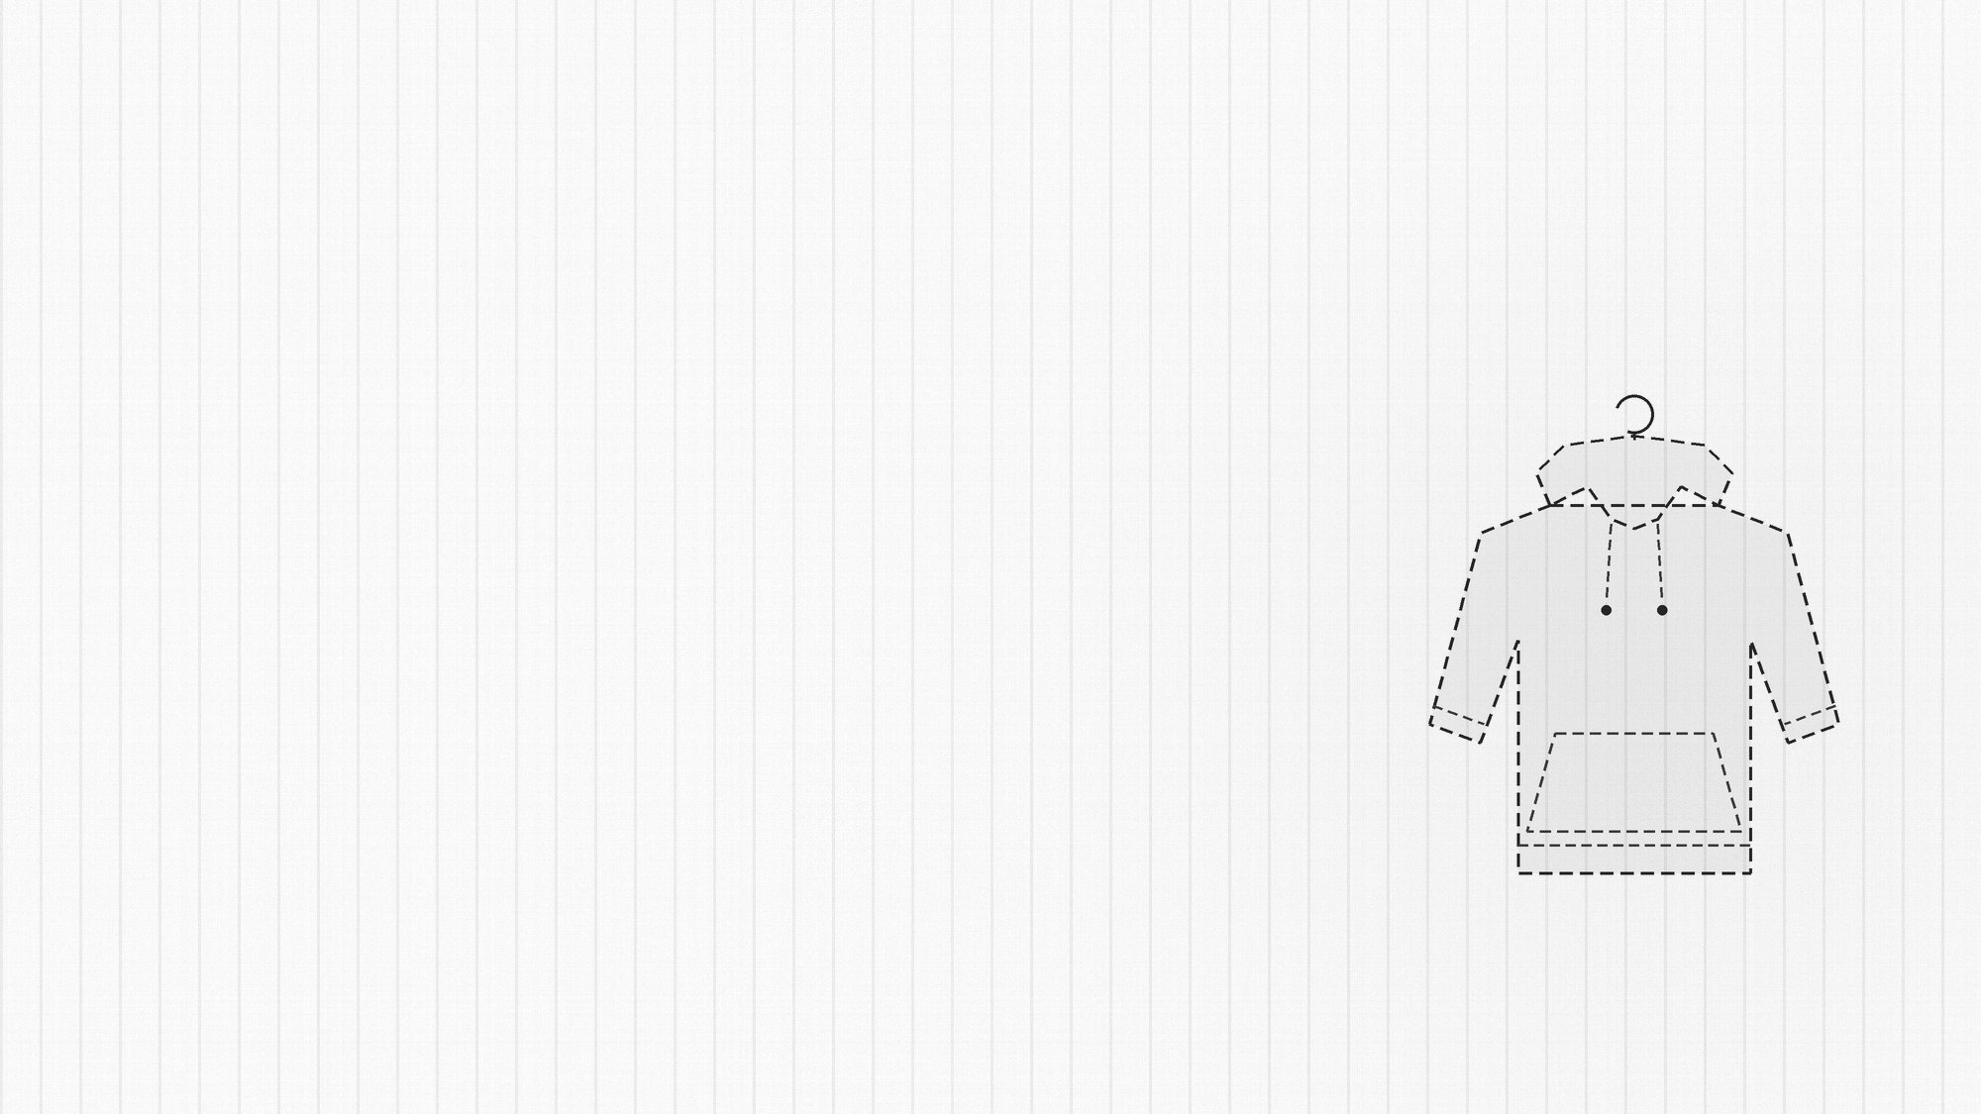
08 / SNITCH CASE STUDY
SNITCH
7–15 Day Content Calendar
Sample 9-day execution plan.
DATE | PLATFORM | FORMAT | CONTENT | OBJECTIVE
D1 | IG | Reel | 3 outfits for college / everyday | Awareness
D2 | IG | Carousel | 5 wardrobe essentials for men | Save/share
D3 | YT | Short | How to style one shirt 3 ways | Consideration
D4 | IG | Creator | Creator fit-check + product tag | Trust
D5 | IG | Reel | New-drop reveal / transition | Product
D6 | FB/IG | Ad | Best sellers + social proof | Conversion
D7 | IG | UGC | #SNITCHYourStyle customer repost | Community
D8 | IG | Carousel | Fit guide + size education | Reduce friction
D9 | IG/CRM | Offer | Personalized new-drop reminder | Retention
Calendar is a proposed portfolio execution plan.
08

Slide 9

09 / SNITCH CASE STUDY
SNITCH
Creatives / Ad Copy
Three sample concepts you can turn into actual Canva creatives.
CREATIVE 01 • REEL
CREATIVE 02 • CAROUSEL
CREATIVE 03 • RETARGETING
VISUAL: Fast outfit transition
HOOK: “One shirt. Three different versions of you.”
CTA: Explore the latest drop.
#SNITCH #MensFashion #OOTD
SLIDE 1: “Your wardrobe needs these 5.”
Slides 2–6: product + styling use case
CTA: Save this for your next shopping trip.
HEADLINE: “Still thinking about the fit?”
BODY: Your saved look is still waiting.
CTA: Complete your look.
Use product image + review/UGC.
Design direction: high-contrast editorial fashion • bold typography • clean product shots • creator-led frames
Ad copy is original portfolio creative; not official SNITCH advertising.
09

Slide 10
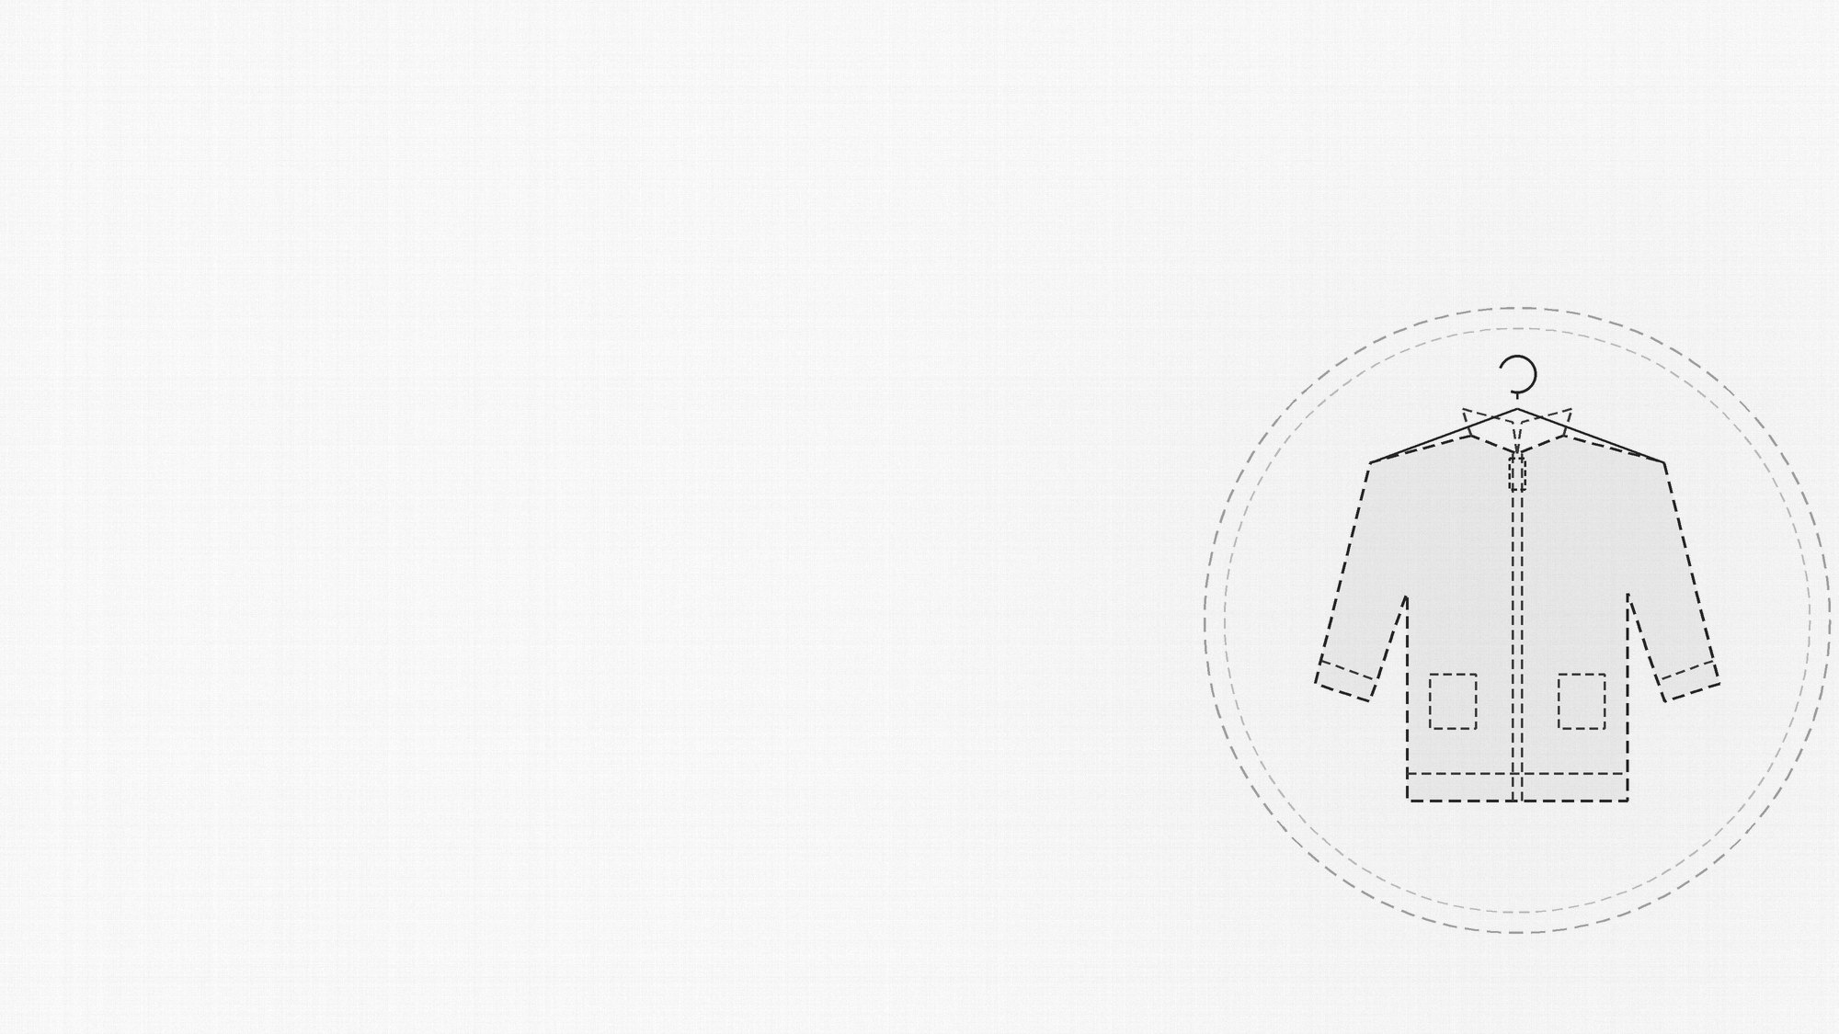
10 / SNITCH CASE STUDY
SNITCH
Paid Strategy
Illustrative 30-day test budget — not SNITCH’s actual media spend.
AWARENESS
CONSIDERATION
CONVERSION
RETARGETING
20% allocation
20% allocation
40% allocation
20% allocation
₹40,000
₹40,000
₹80,000
₹40,000
AUDIENCE
ILLUSTRATIVE TOTAL
18–30 fashion interests • video viewers • website visitors • ATC • 1%–3% lookalikes
₹2,00,000
/ 30 days
BIDDING
Start with lowest-cost / maximize conversions; move toward value optimization after sufficient conversion volume.
Budget, audience and bidding are proposed for a portfolio simulation.
10

Slide 11
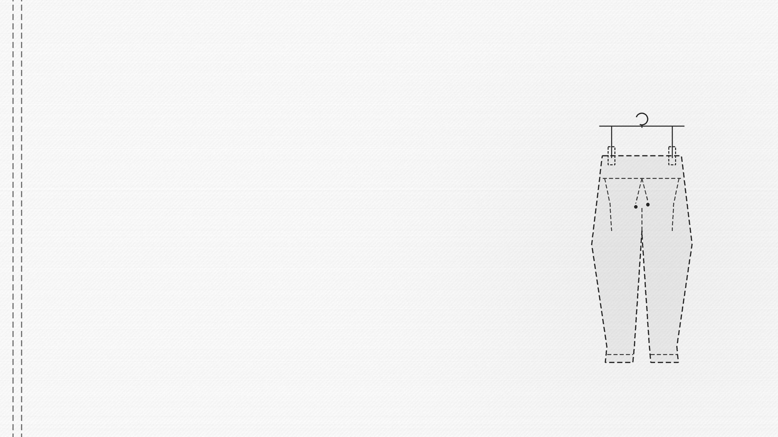
11 / SNITCH CASE STUDY
SNITCH
KPIs + Forecast
Illustrative targets for a 30-day test — targets are not historical results.
CTR
CPC
CVR
Target: >1.5%
Target: ↓ 10%
Target: +10–20%
Driver: Creative relevance
Driver: Traffic efficiency
Driver: Landing-page + offer
CAC
ROAS
REPEAT RATE
Target: ↓ 10%
Target: 2.5–3.5x
Target: +10–15%
Driver: Acquisition efficiency
Driver: Paid revenue efficiency
Driver: CRM + retention
FORECAST PRINCIPLE
Do not promise a fixed revenue number before testing. Forecast from traffic × conversion × AOV, then validate against actual CAC and contribution margin.
Targets are hypothetical planning assumptions for this case study.
11

Slide 12

12 / SNITCH CASE STUDY
SNITCH
Learning + Conclusion
What this case study teaches a digital marketer
TAKEAWAY 01
TAKEAWAY 02
TAKEAWAY 03
Content should not be treated as decoration. Strong creative is a demand-generation asset that can feed paid media.
Growth is not only acquisition. CRM, repeat purchase, cross-sell and LTV determine whether paid traffic becomes durable value.
The strongest omnichannel model connects social discovery, D2C conversion, physical retail and customer data.
FINAL FRAMEWORK
CONTENT
→
TRAFFIC
→
CONVERSION
→
RETENTION
→
LIFETIME VALUE
Sources: SNITCH official website; Inc42; Economic Times. Strategy and forecast sections are portfolio recommendations.
12

